Slide 1
EuroAir
Methodology of Programming (JAVA) Project
UPDATED

Slide 2
Group Members
Susan Koko – TYZ8PV
Guo Ruizheng – YT6WA9
Deng Zhihui – TWBGQJ
Su Haobo – C7VQKI

Slide 3
Project Summary
The proposed airline reservation system is a web based Java project
It is a comprehensive passenger processing system that includes e-ticket operations. The main features of this airline reservation system are:
Printing of E-tickets
Maintaining passenger records in database

Slide 4
Technology Stack
USERS
FrontEnd
(HTML/CSS)
BackEnd
(Java)
Database
(MySql/PHP)

Slide 5
MYSQL (GUO RUIZHENG)
User
Personal information
Contact details
EUROAIR
Flight information
Flight
Payment

Slide 6

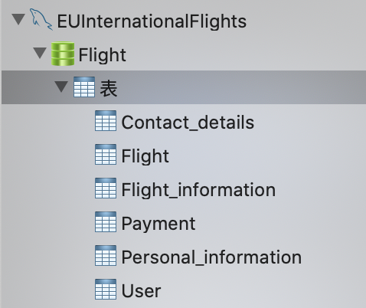
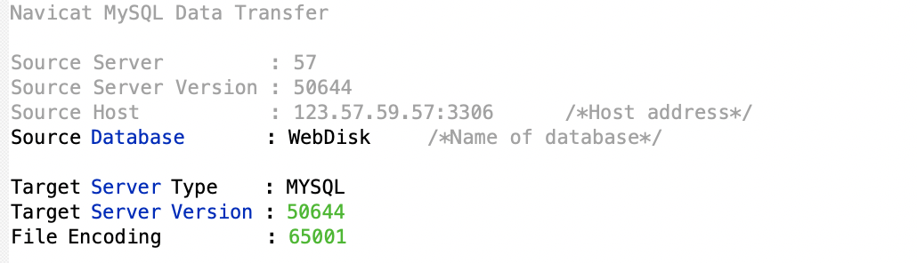
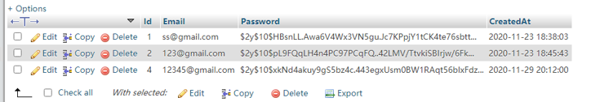
MYSQL (GUO RUIZHENG)
Basic setting
TABLES
User
(hash)

Slide 7
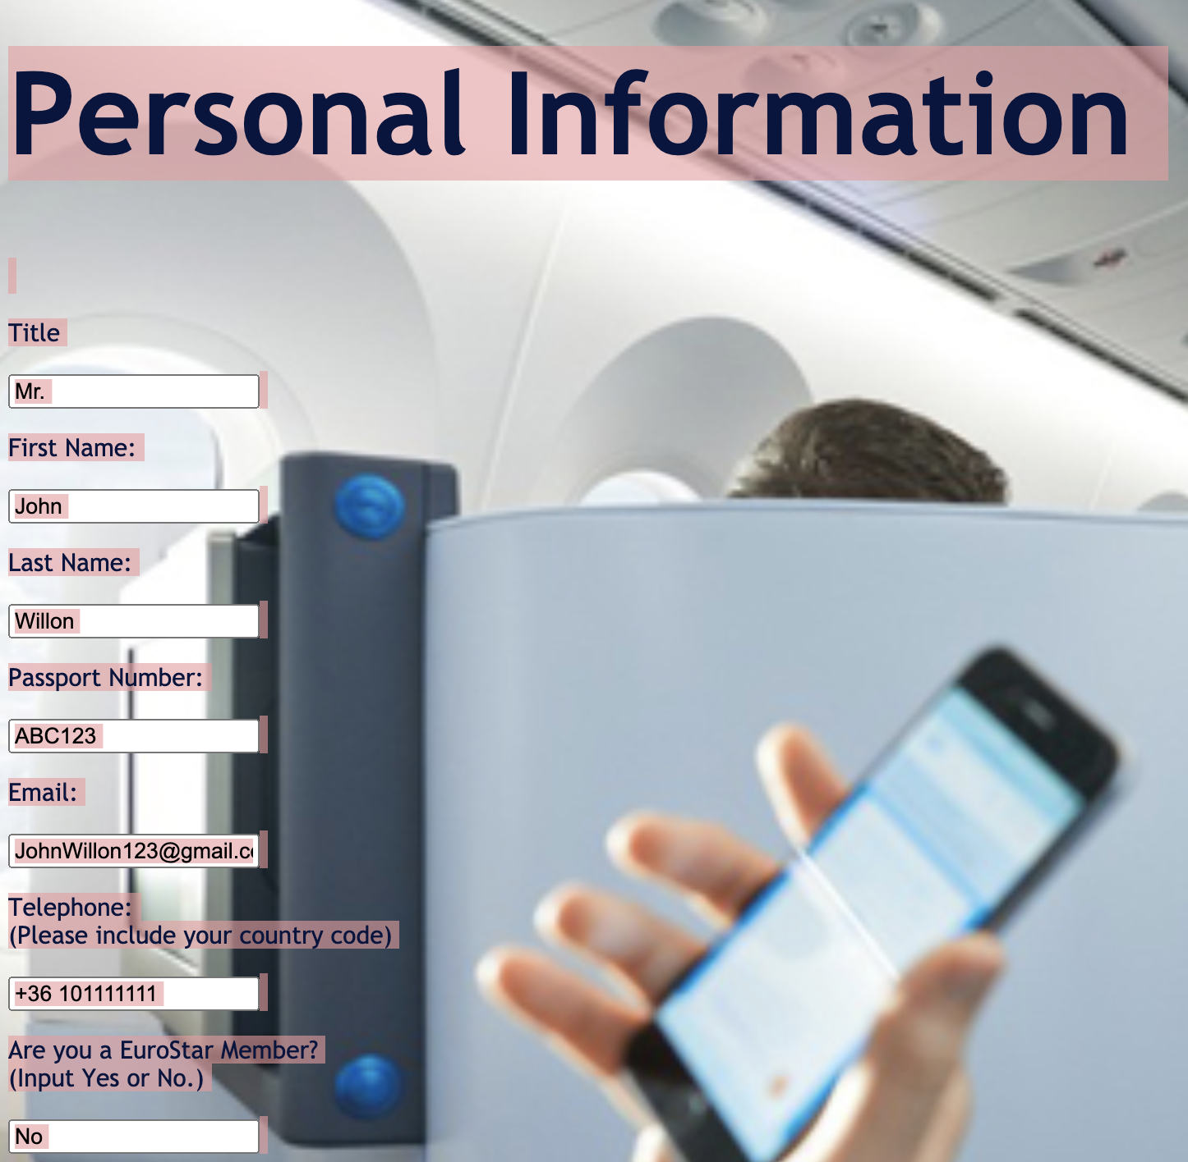
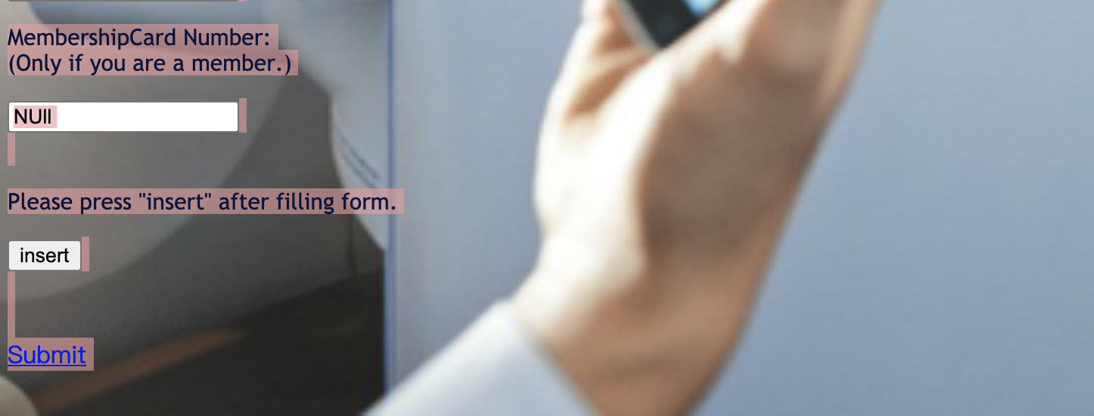
MYSQL (GUO RUIZHENG)

Slide 8
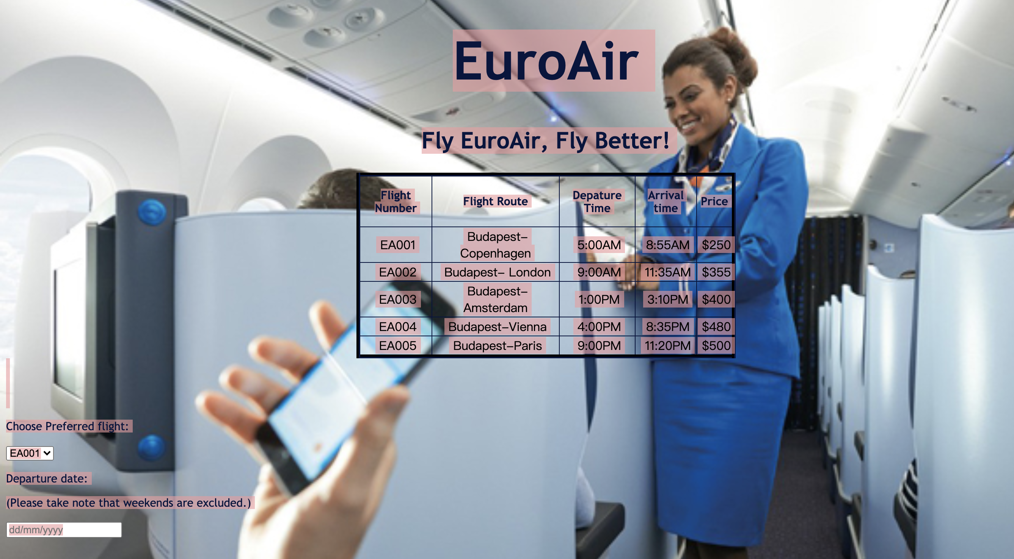
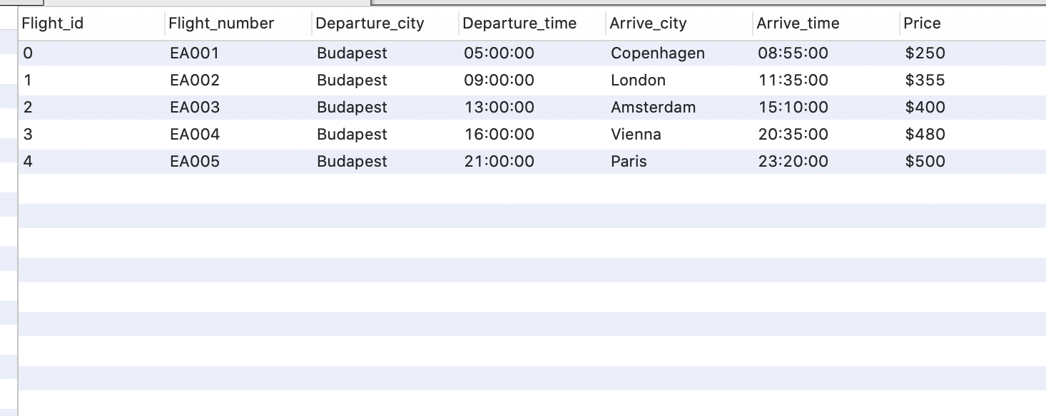
MYSQL (GUO RUIZHENG)

Slide 9
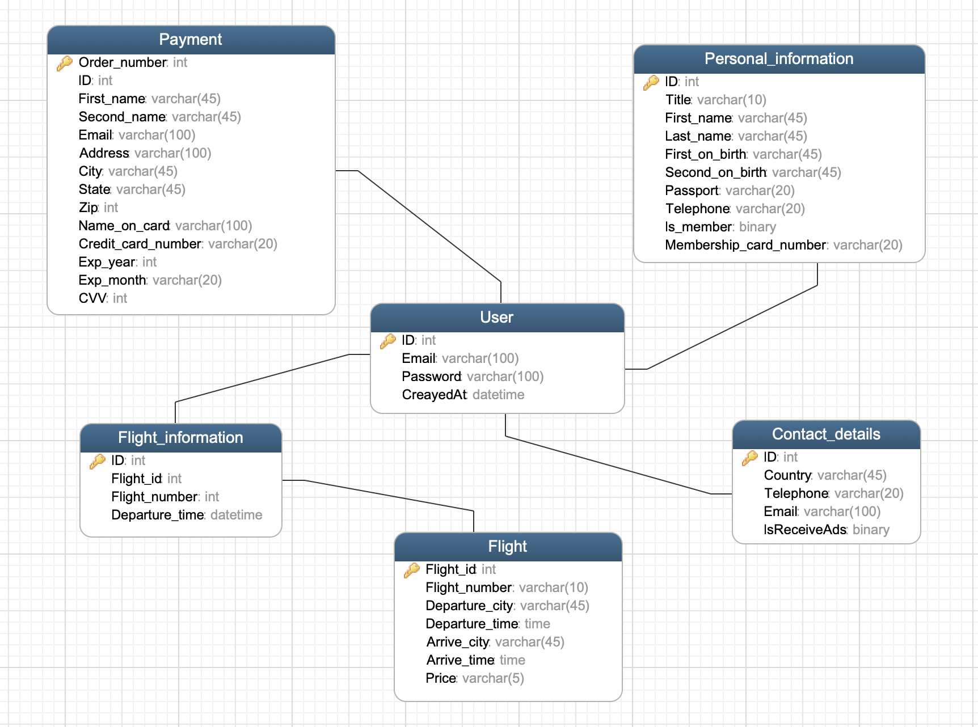
MYSQL (GUO RUIZHENG)
Table details

Slide 10
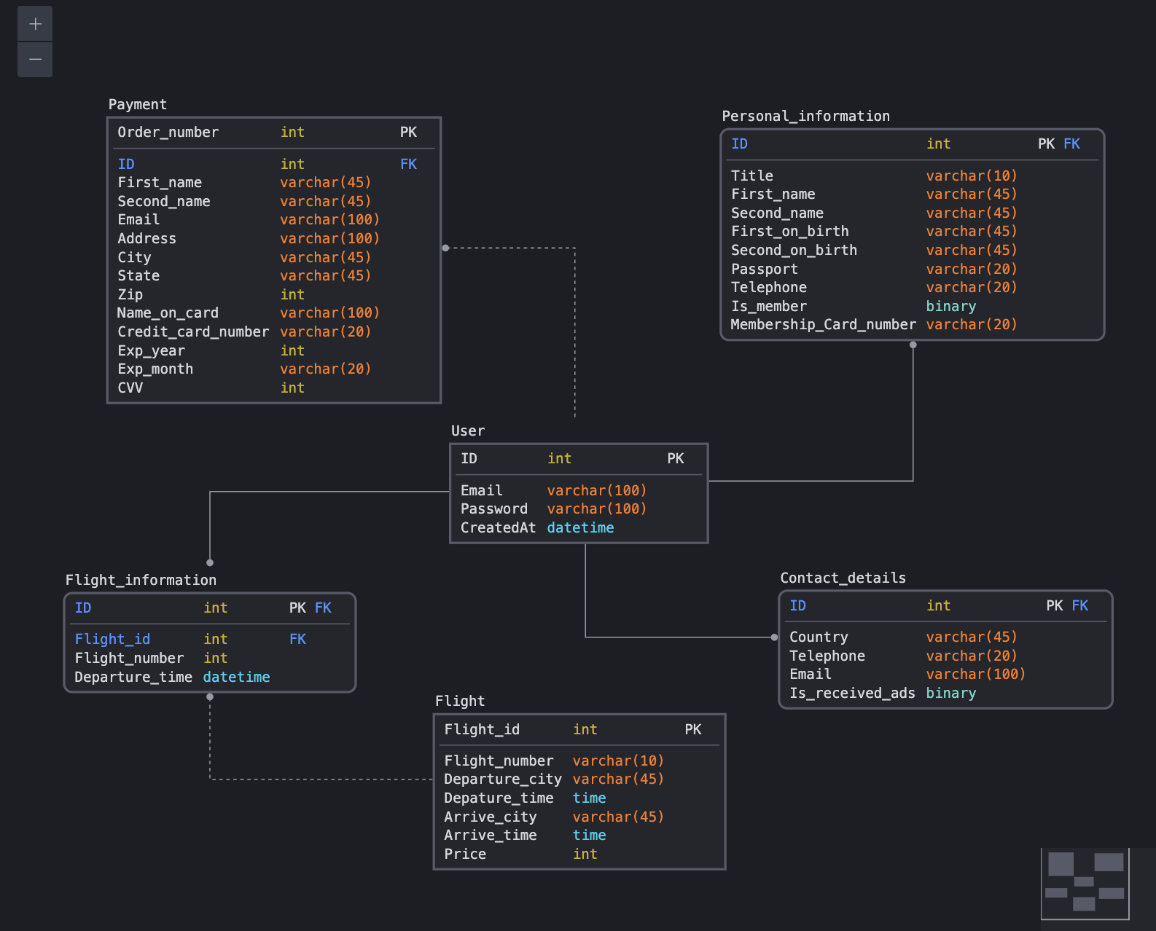
MYSQL (GUO RUIZHENG)

Slide 11
PHP
DENG ZHIHUI
TWBGQJ

Slide 12
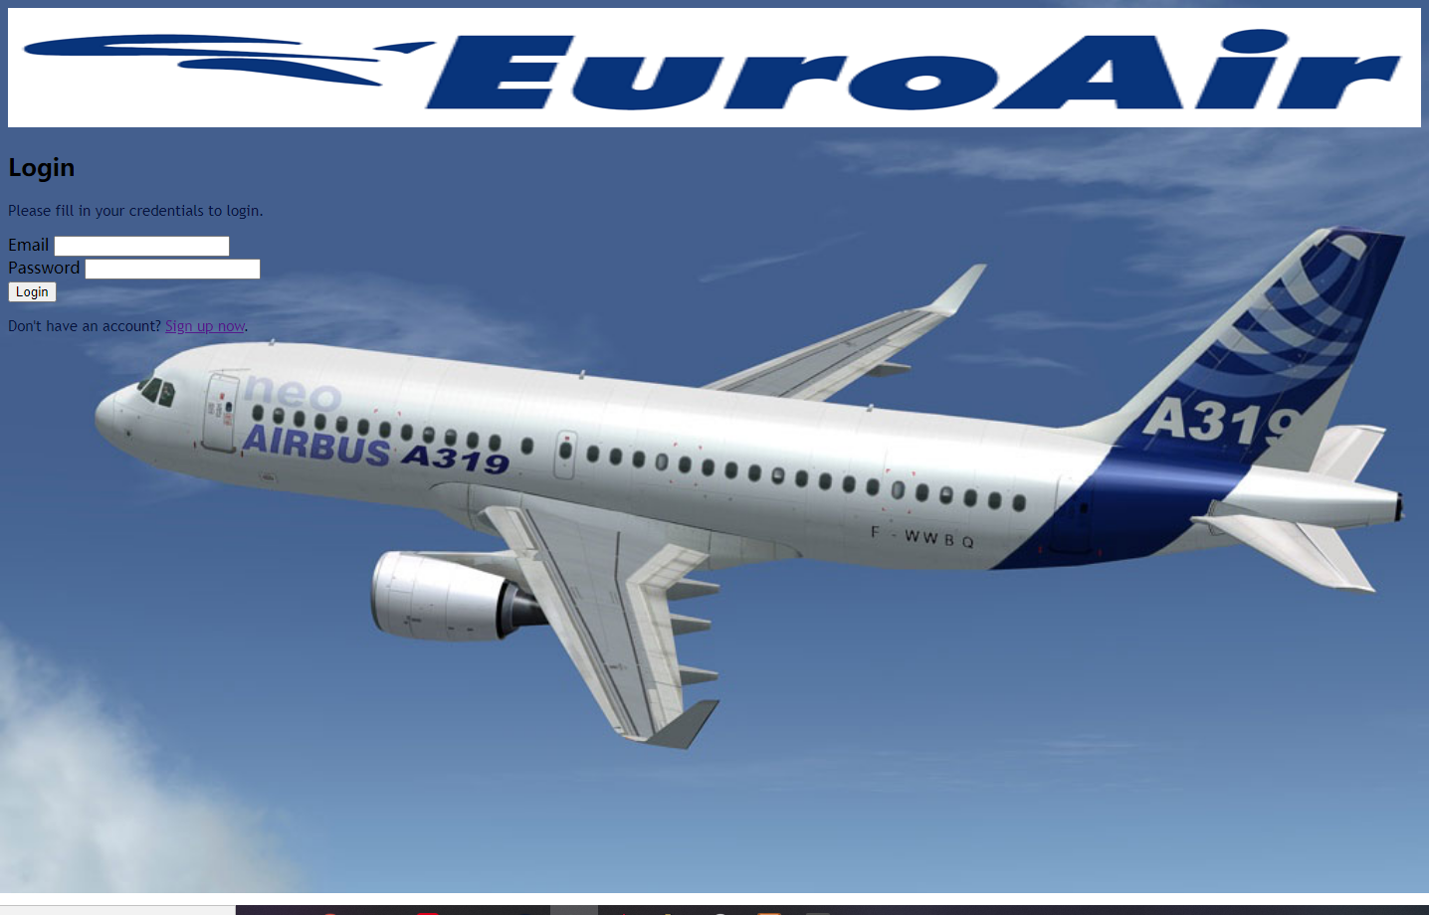

Slide 13
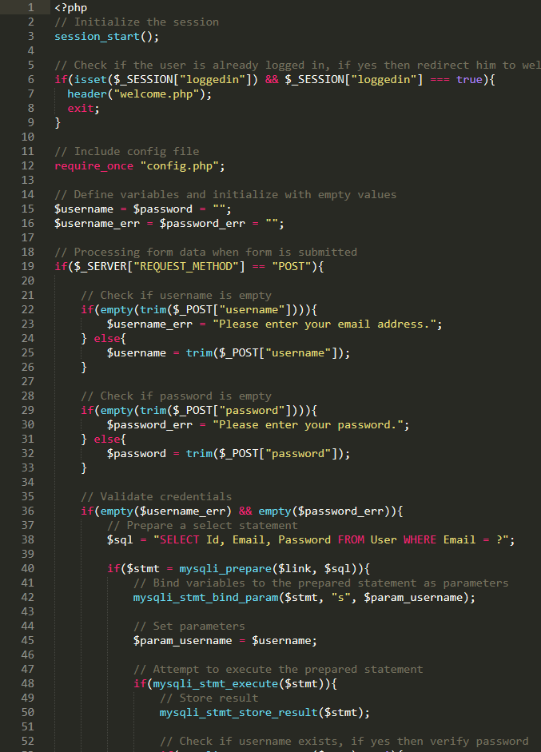
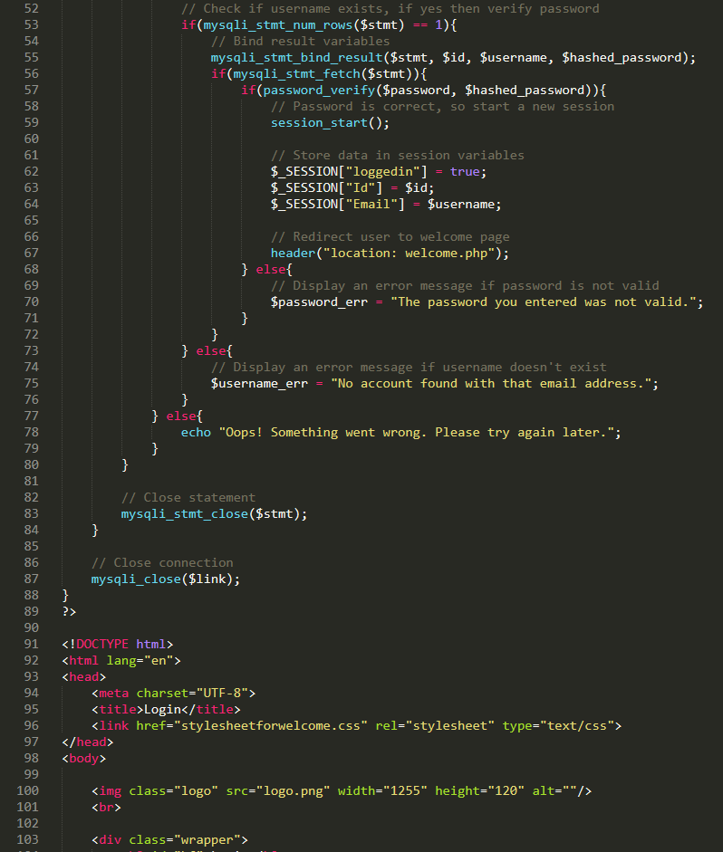
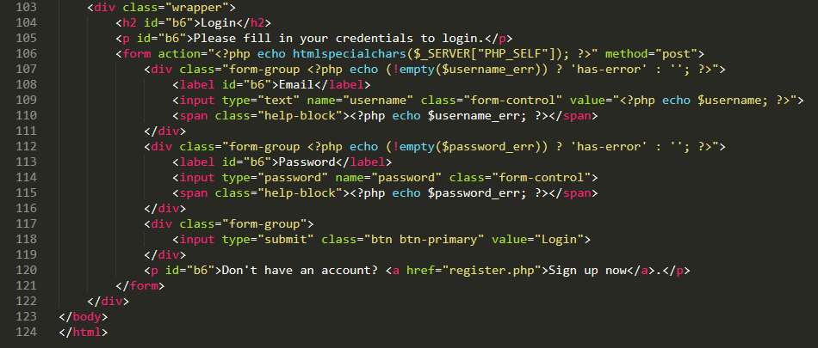

Slide 14
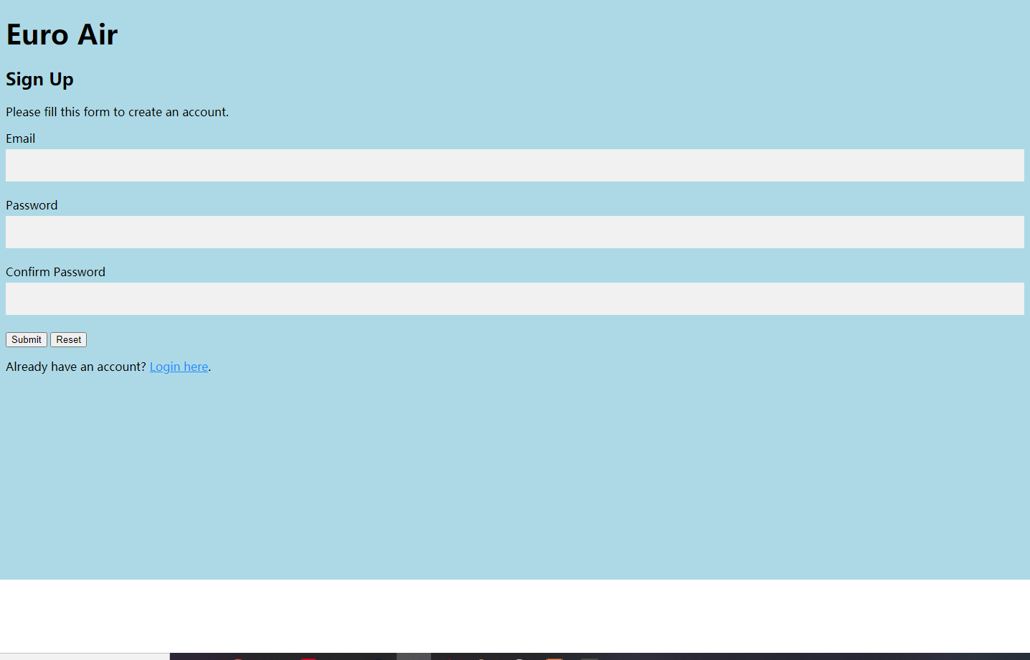

Slide 15
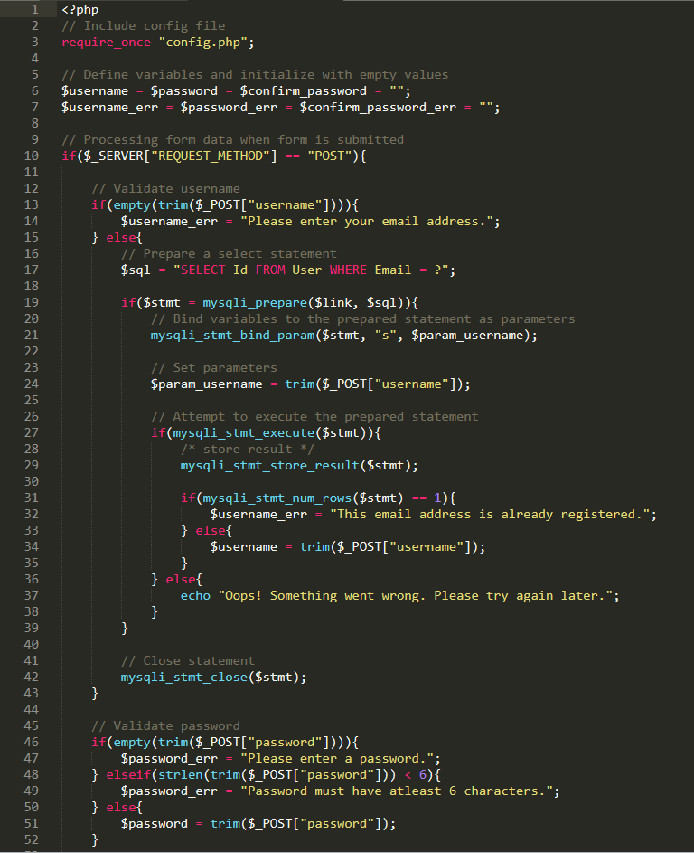
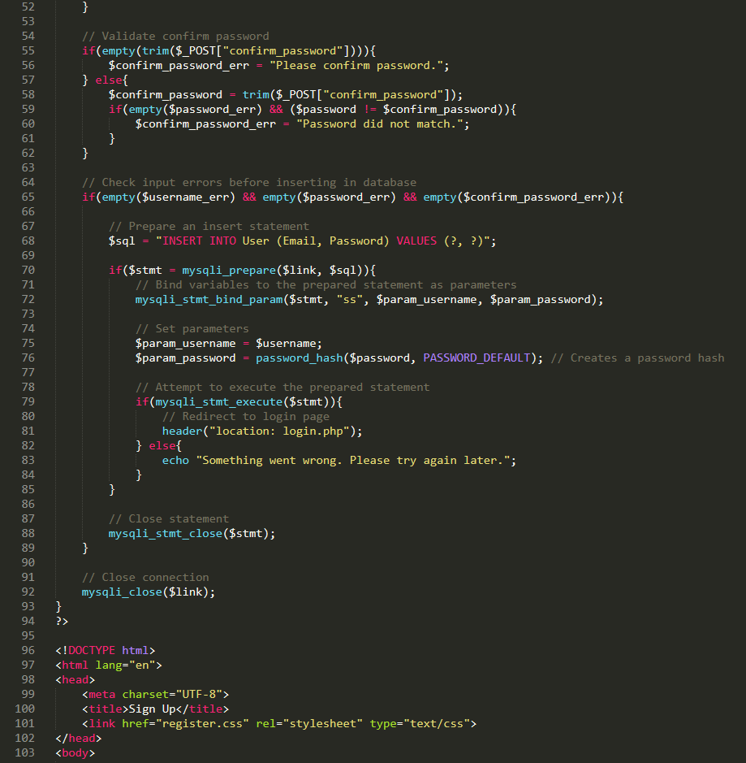
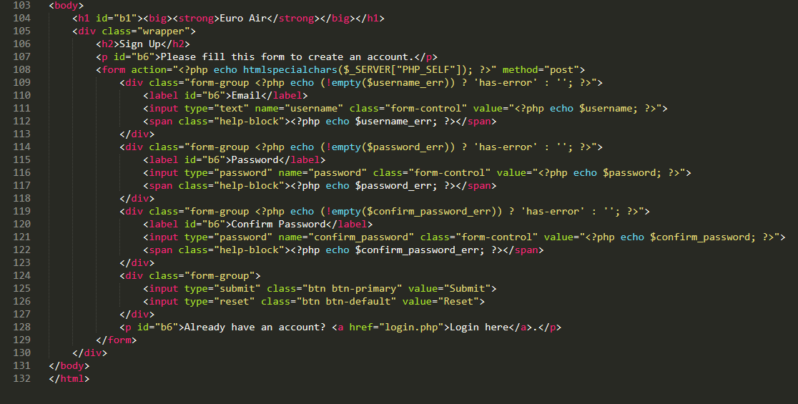

Slide 16


Slide 17
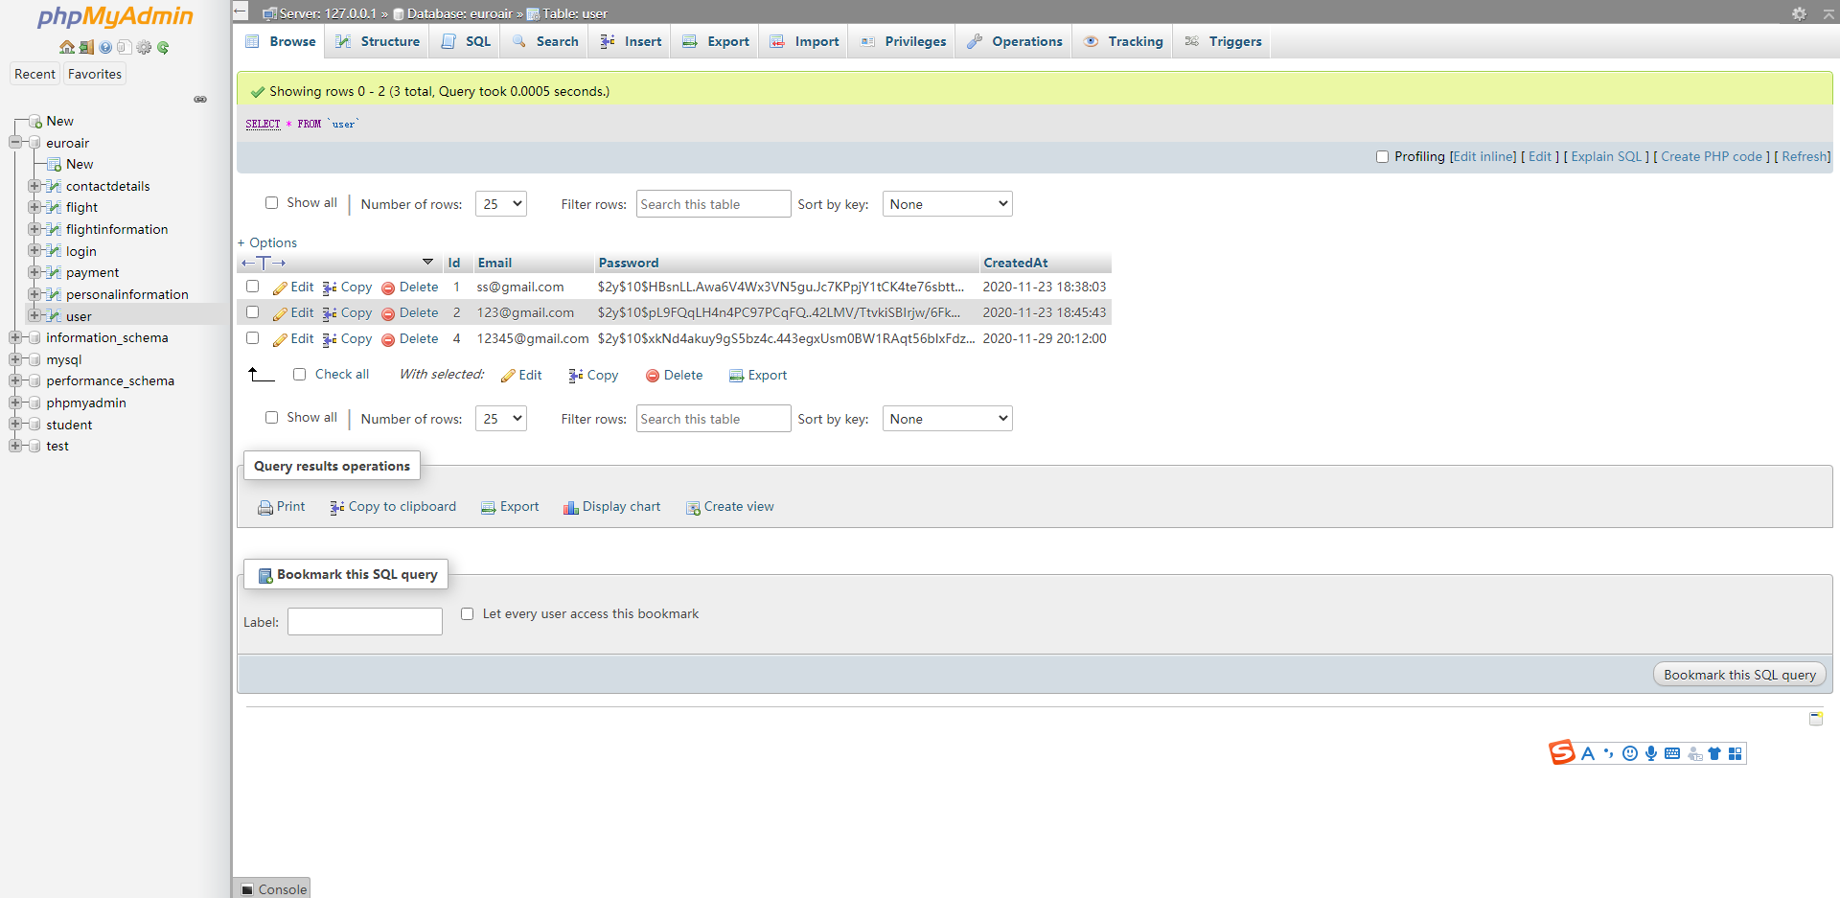

Slide 18


Slide 19
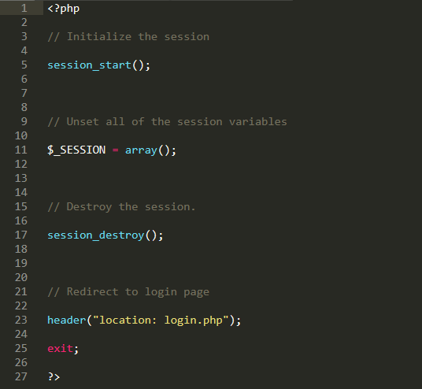

Slide 20
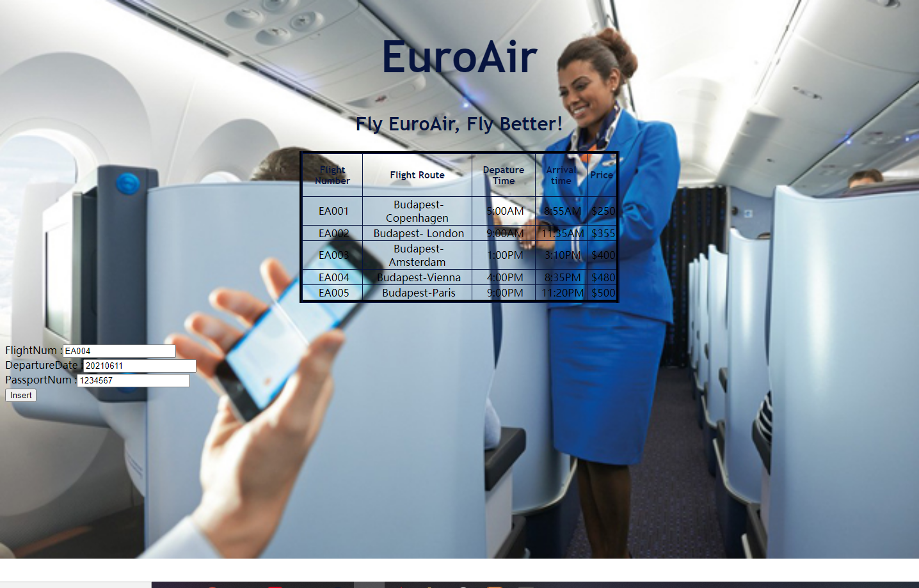

Slide 21
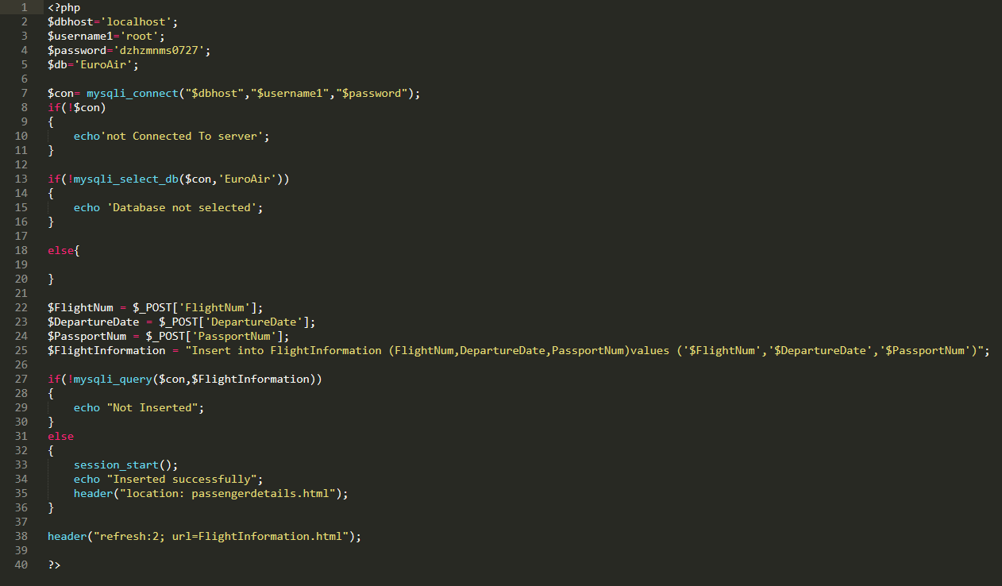

Slide 22
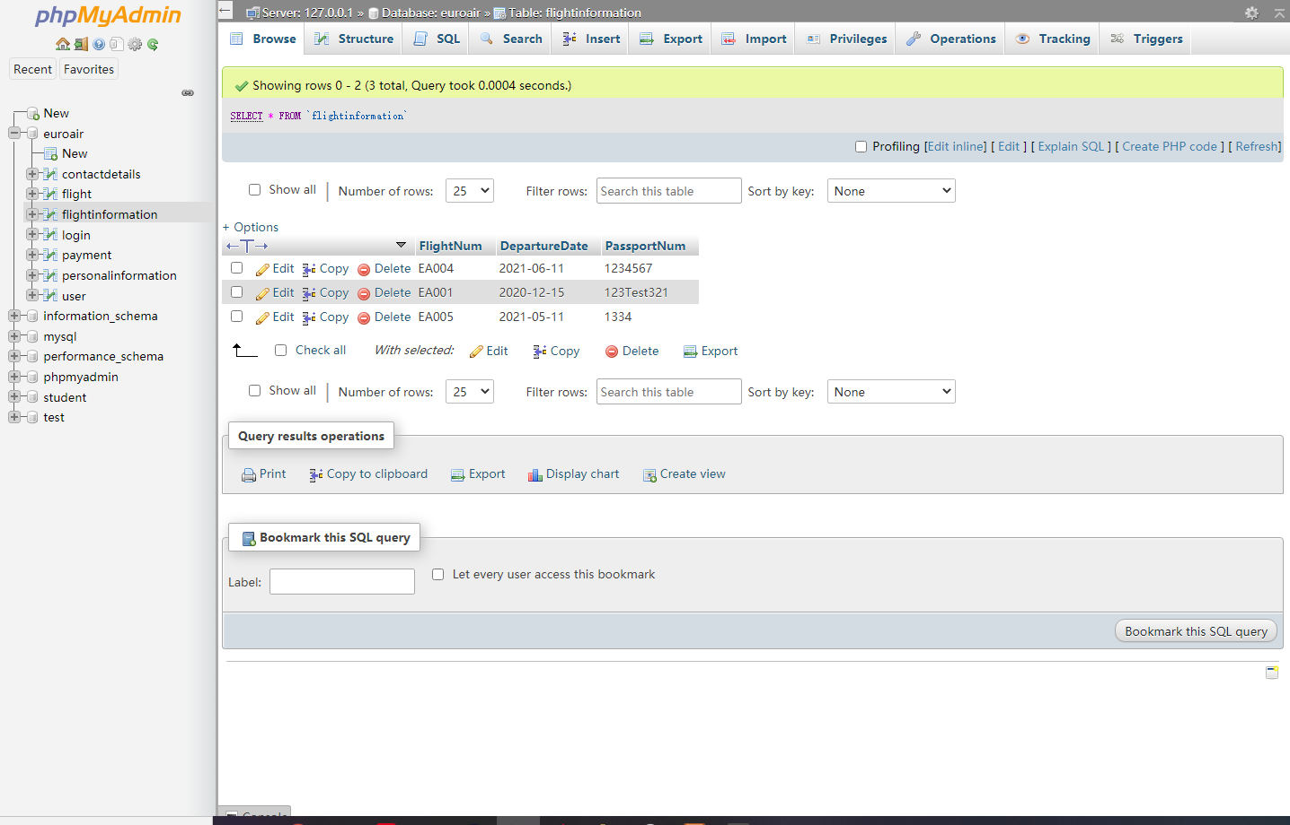

Slide 23
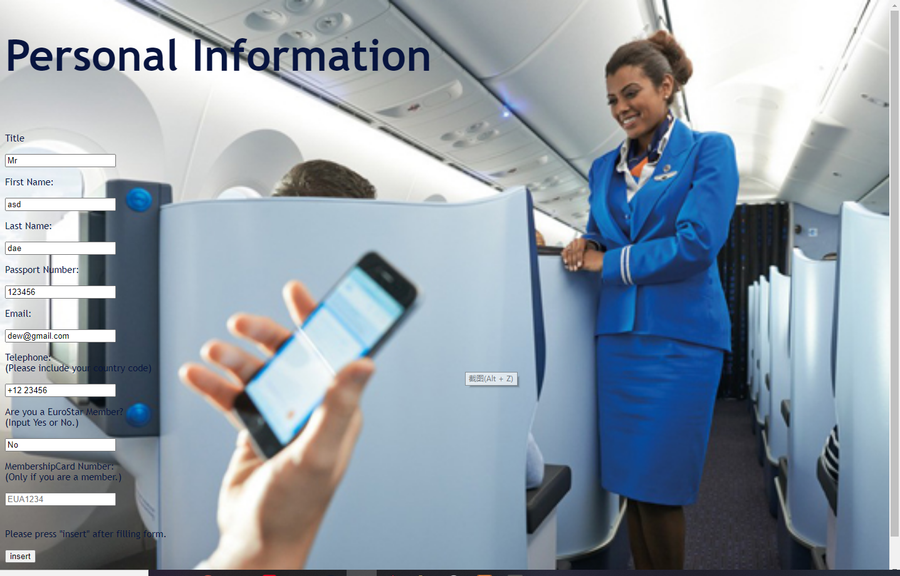

Slide 24
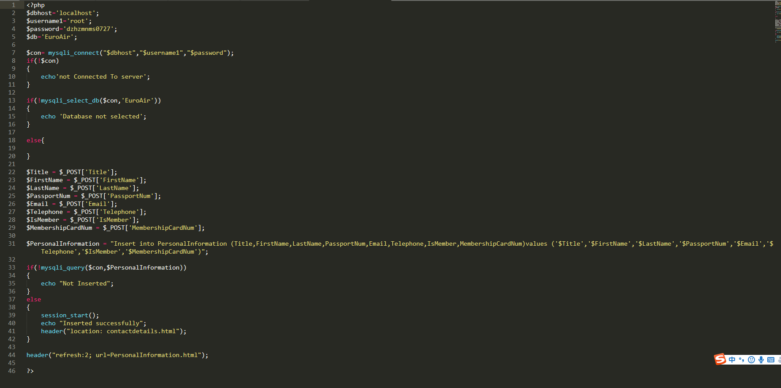

Slide 25
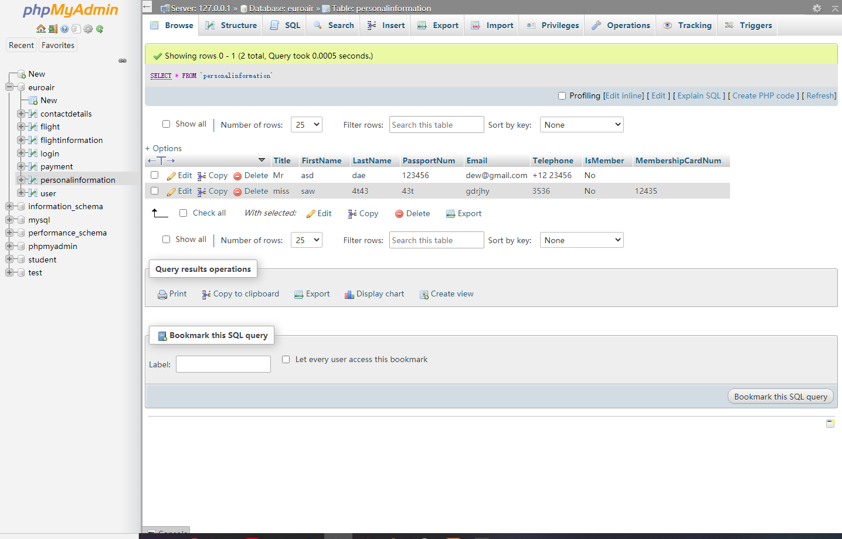

Slide 26
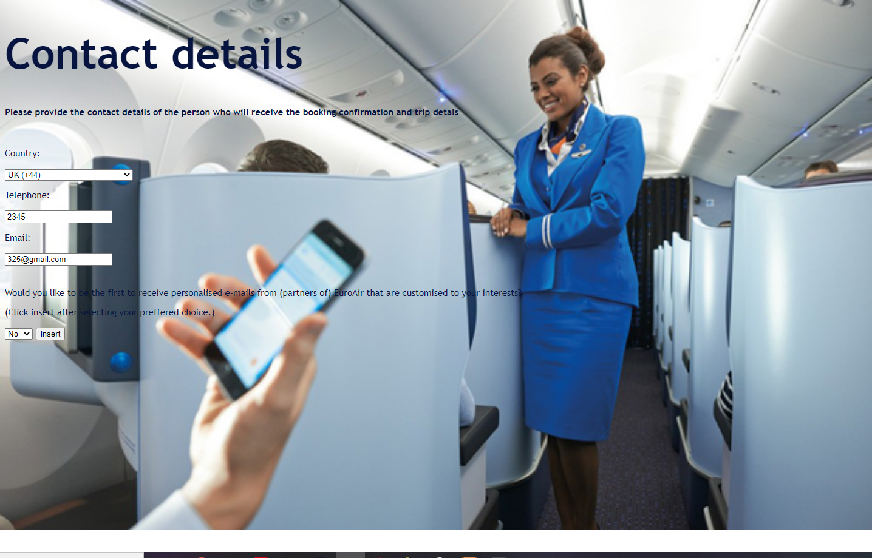

Slide 27
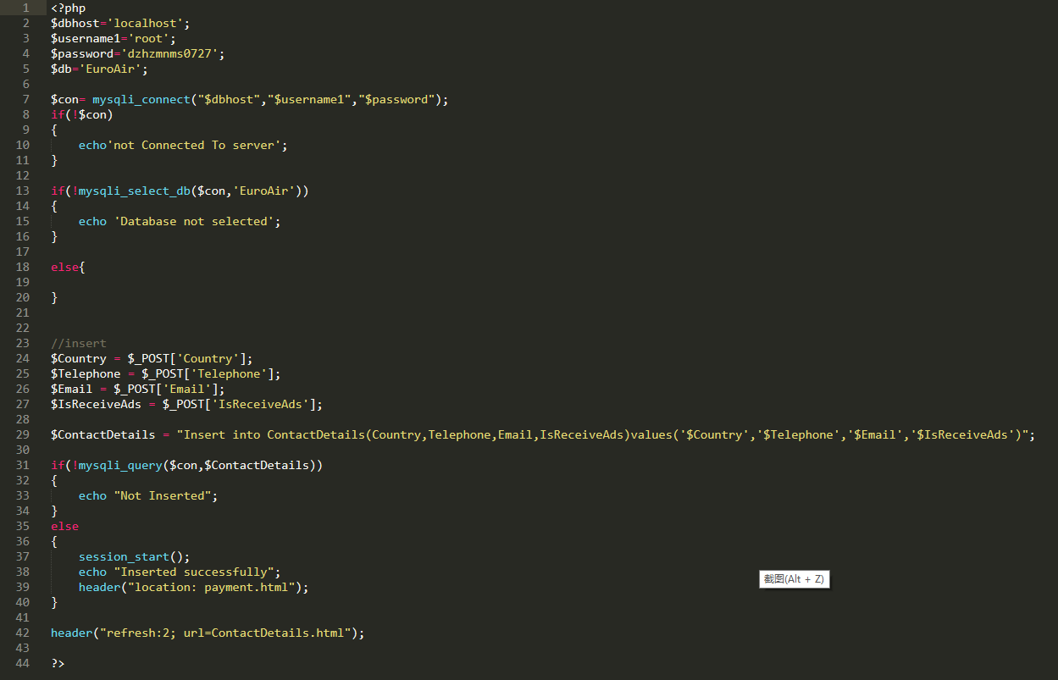

Slide 28
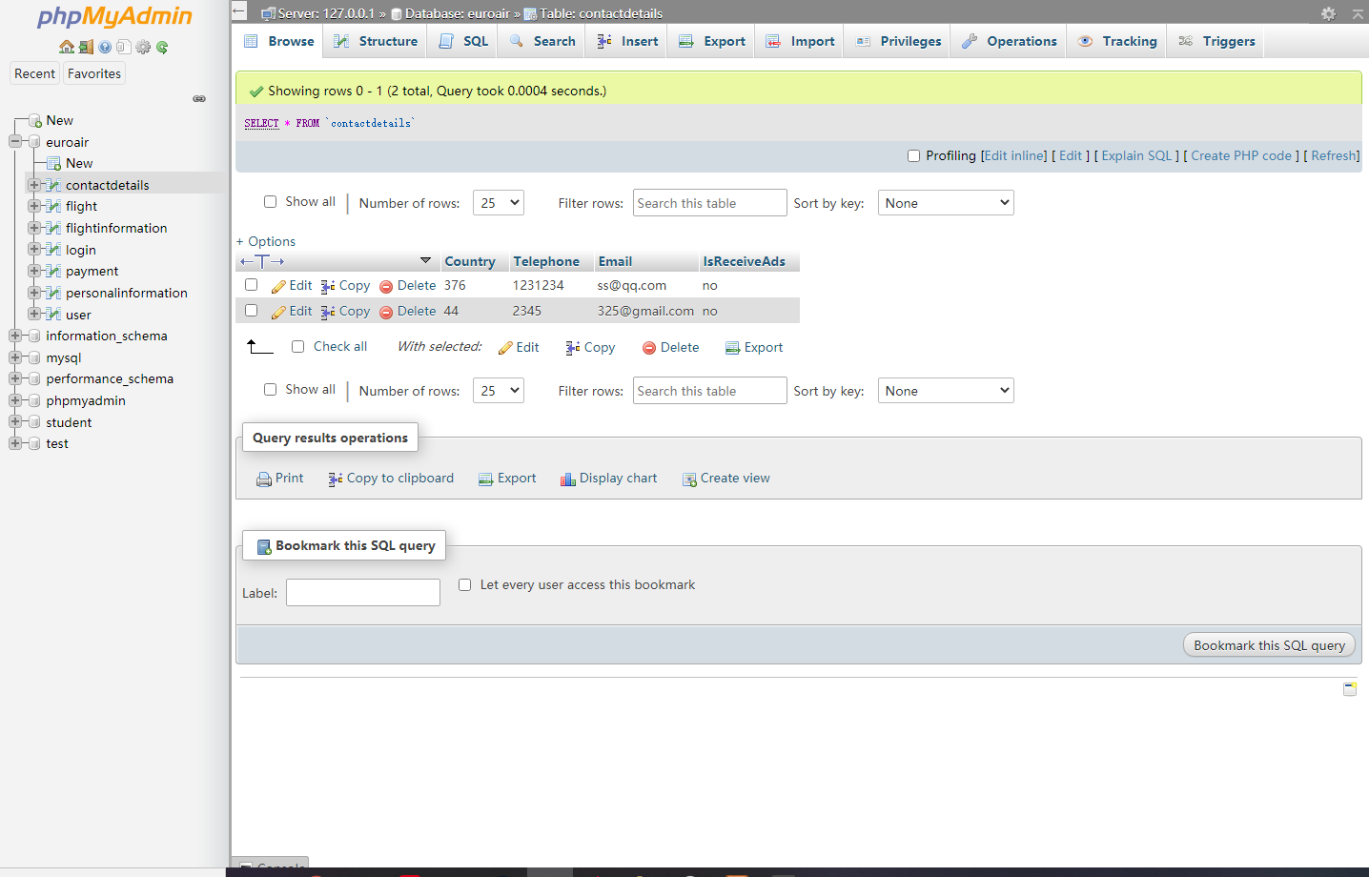

Slide 29
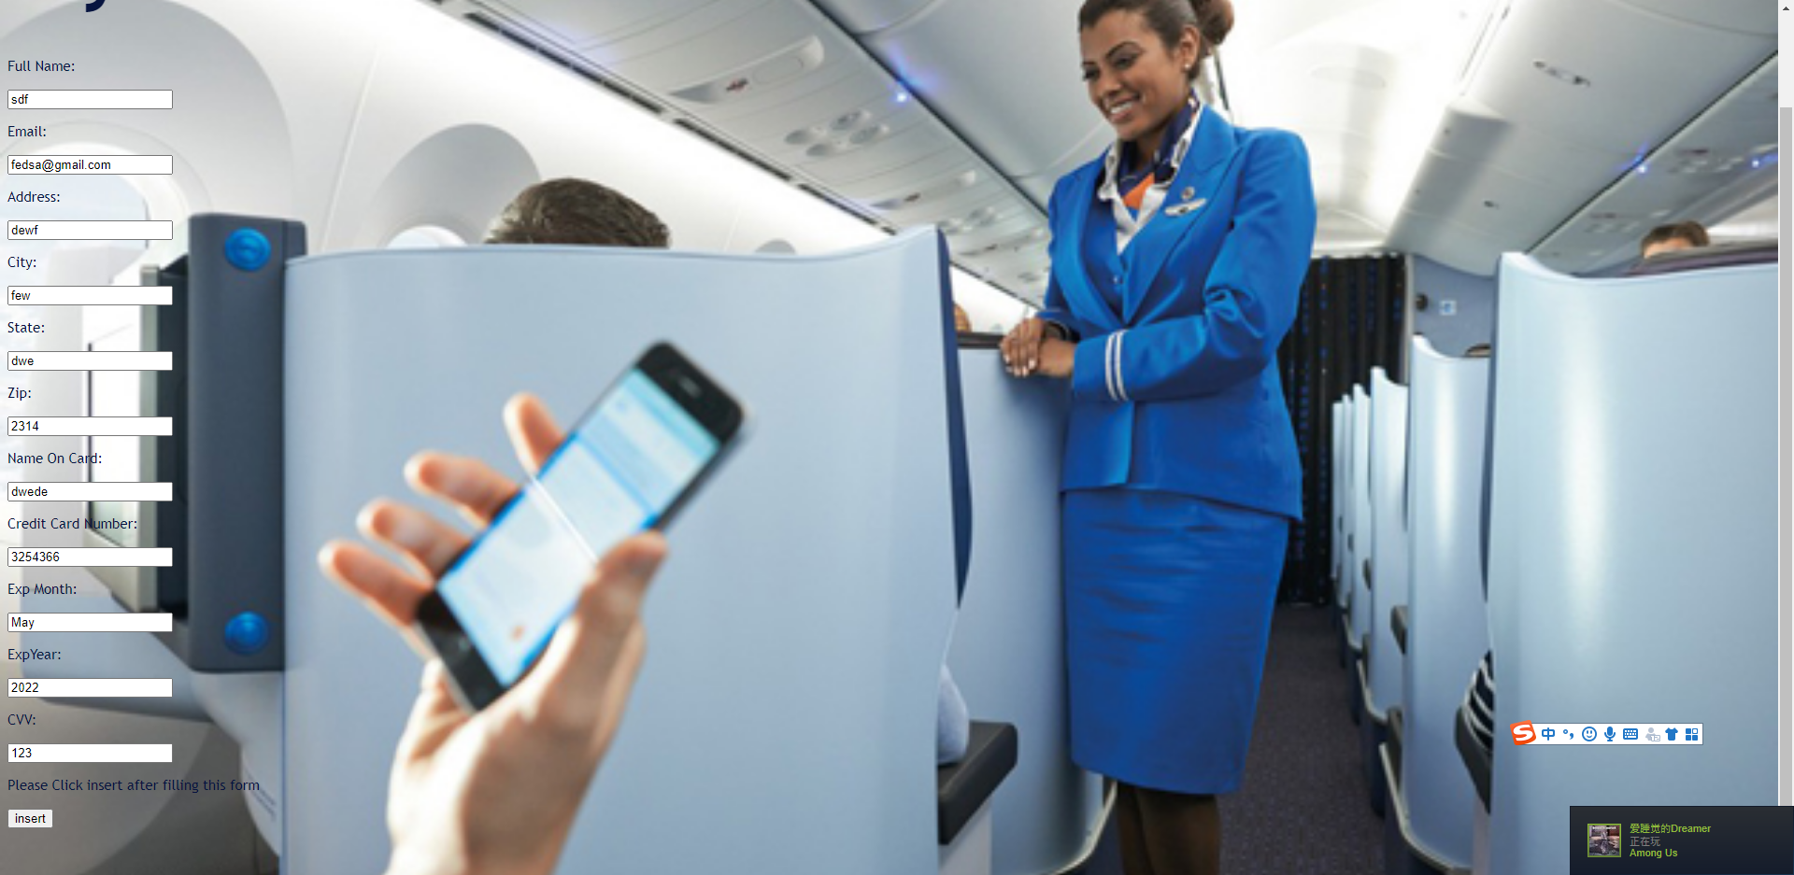

Slide 30
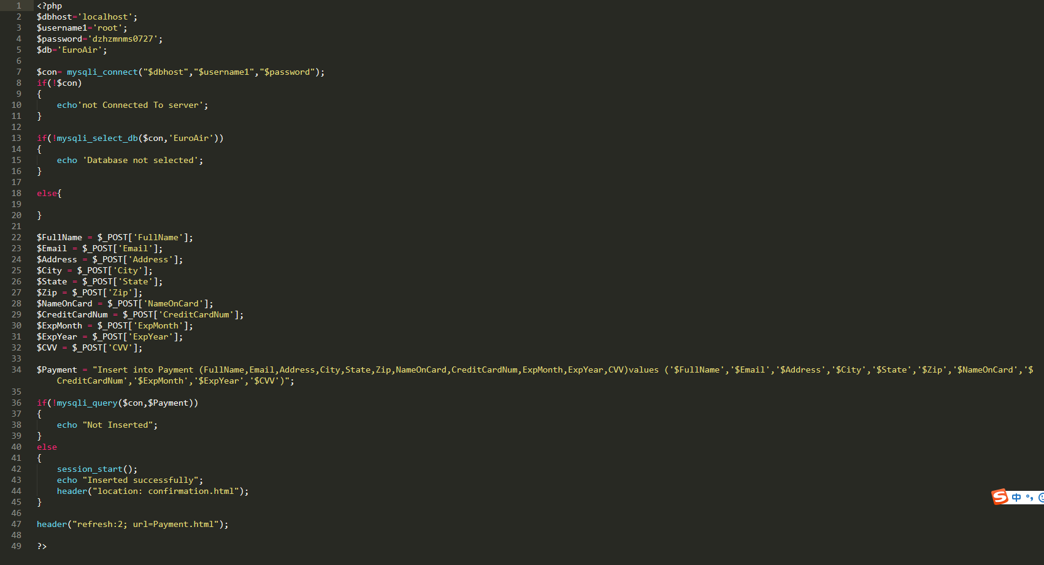

Slide 31
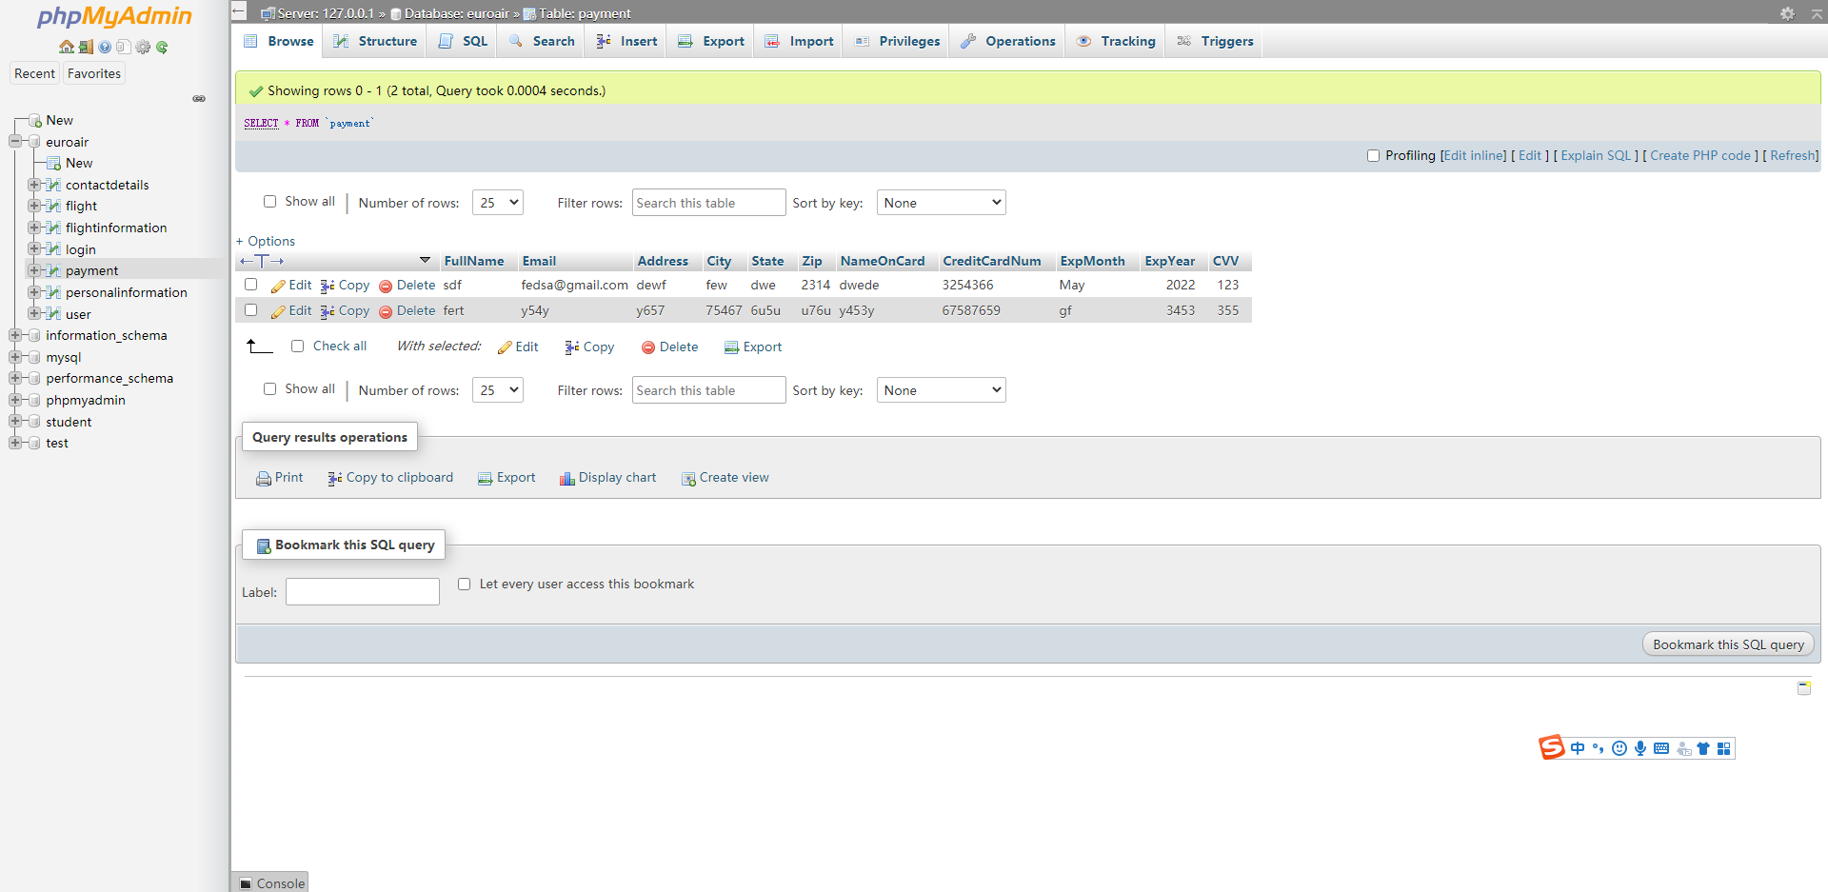

Slide 32
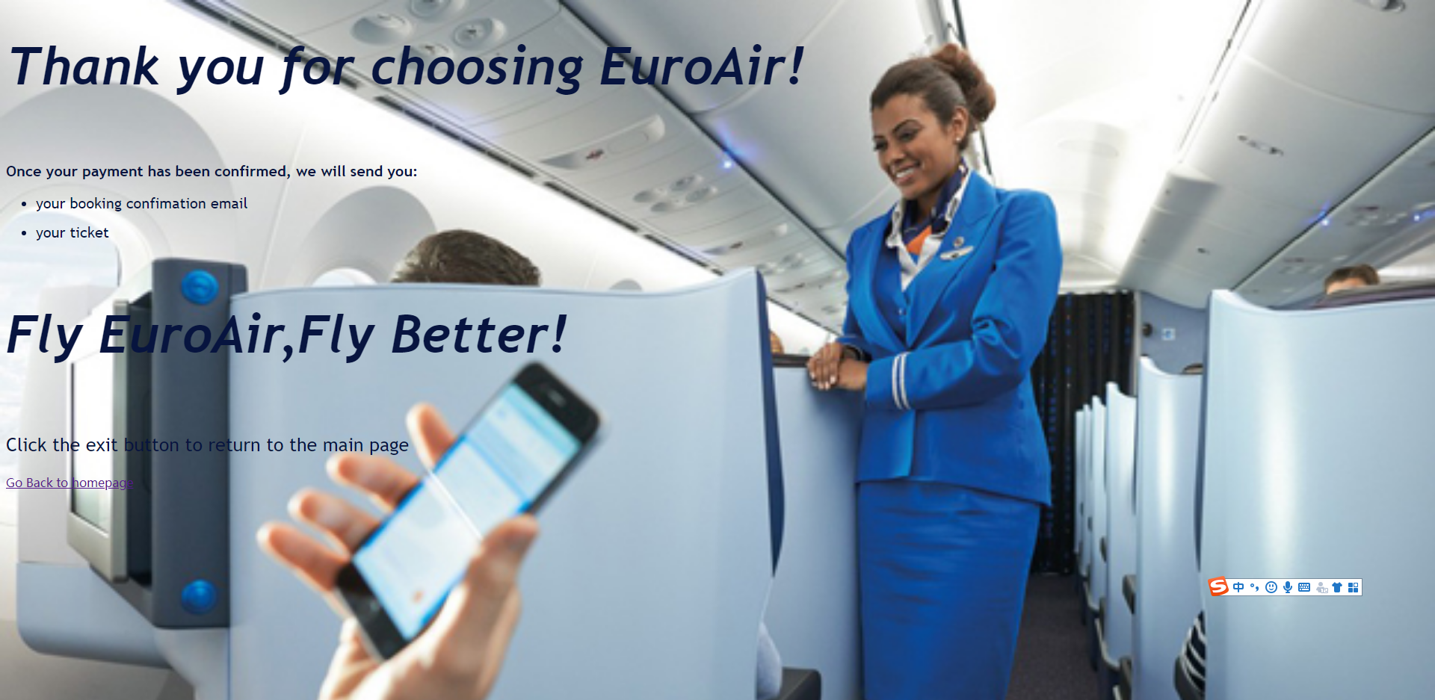

Slide 33
Java for connect to database and print it with pdf
Su Haobo

Slide 34
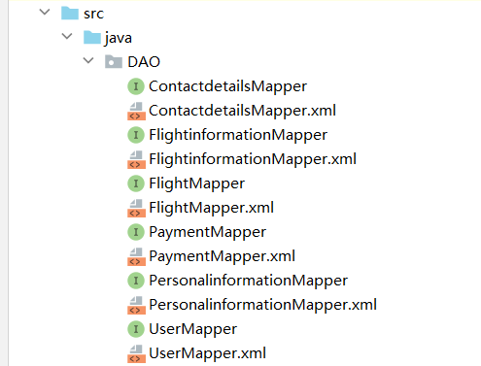
At the first
I used mybatis.MyBatis is an excellent persistence layer framework that supports custom SQL, stored procedures, and advanced mapping. MyBatis eliminates almost all JDBC code and the work of setting parameters and obtaining result sets. MyBatis can configure and map primitive types, interfaces and Java POJOs (Plain Old Java Objects) as records in the database through simple XML or annotations.
mybatis related files

Slide 35
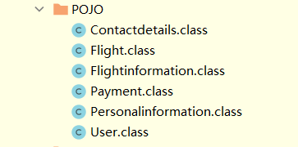
The entity corresponding to the table in the database, each entity is a column of the table

Slide 36
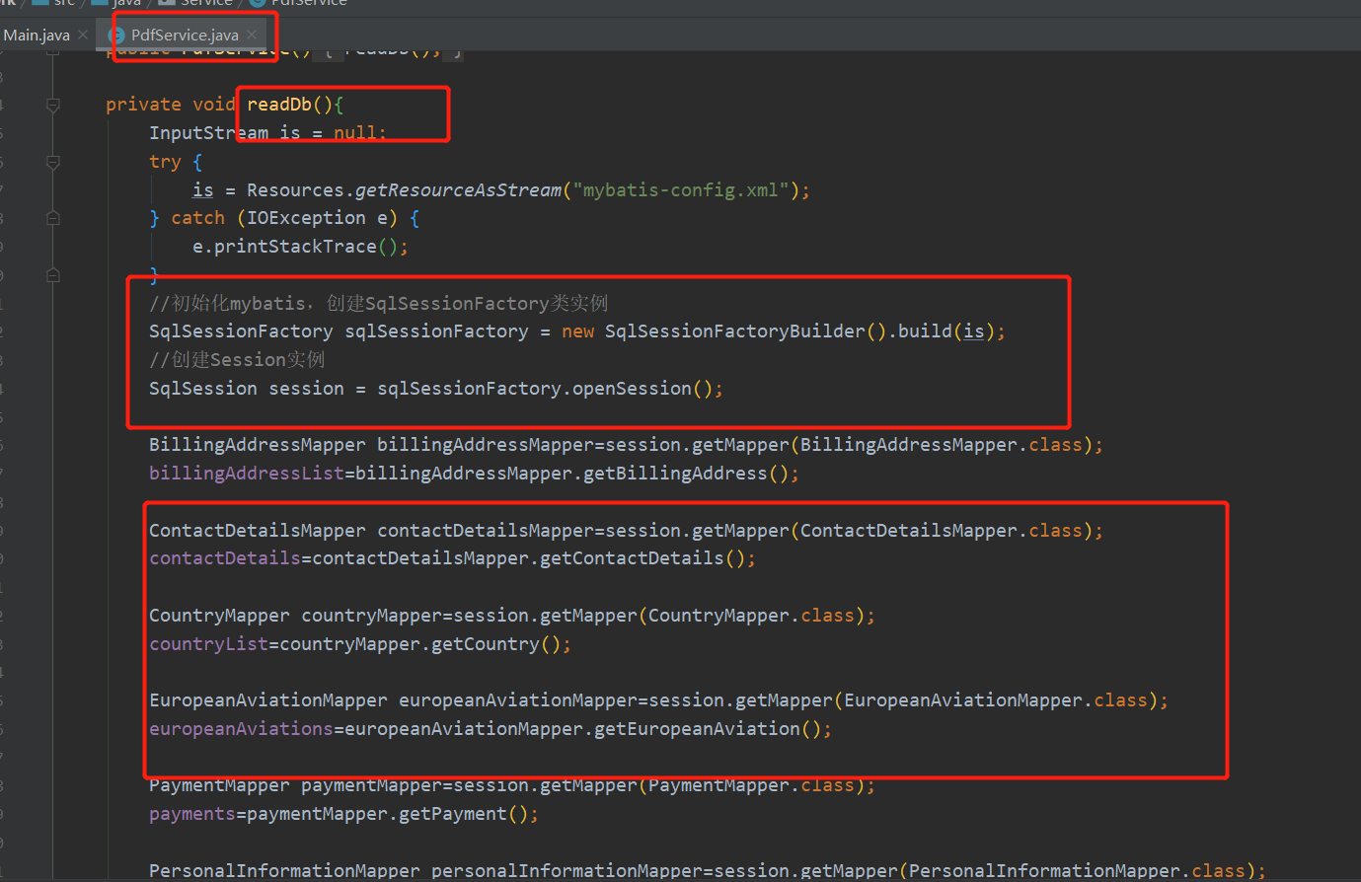
Mybatis reads data and stores it in each List

Slide 37
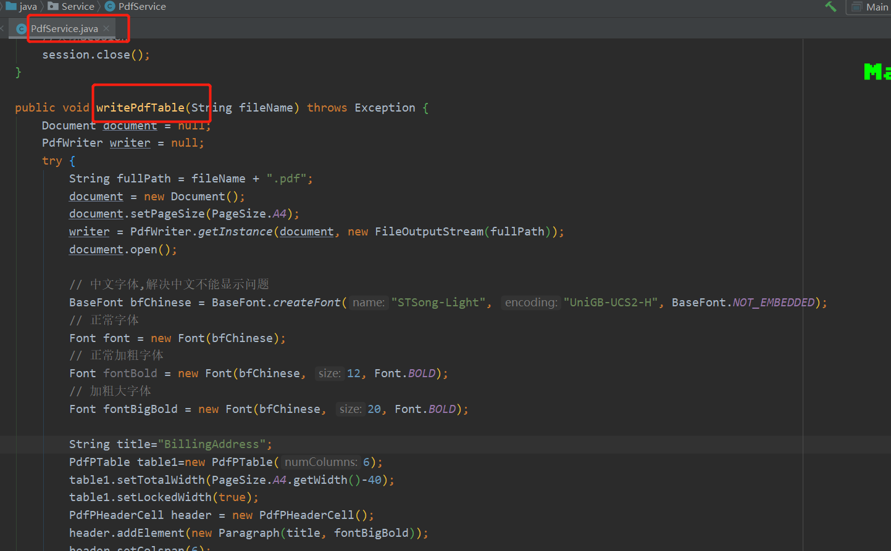
Write the read data to the pdf file, using the jar package of itextpdf

Slide 38
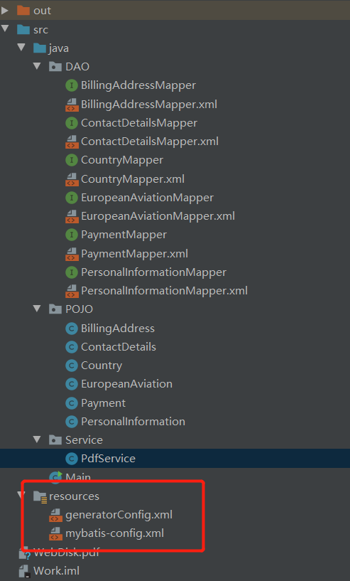
The configuration file, the first one is used to generate those files under the DAO package. It is mybatis reverse engineering. The corresponding code is generated according to the table structure in the database, without the need for human handwriting
The second file is used by jdbc to connect to the database. It contains the ip address of the database server and the type of database used, as well as the user name and password.

Slide 39
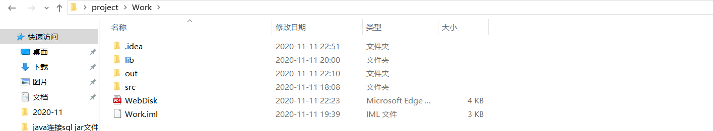
The new pdf will download in this file

Slide 40
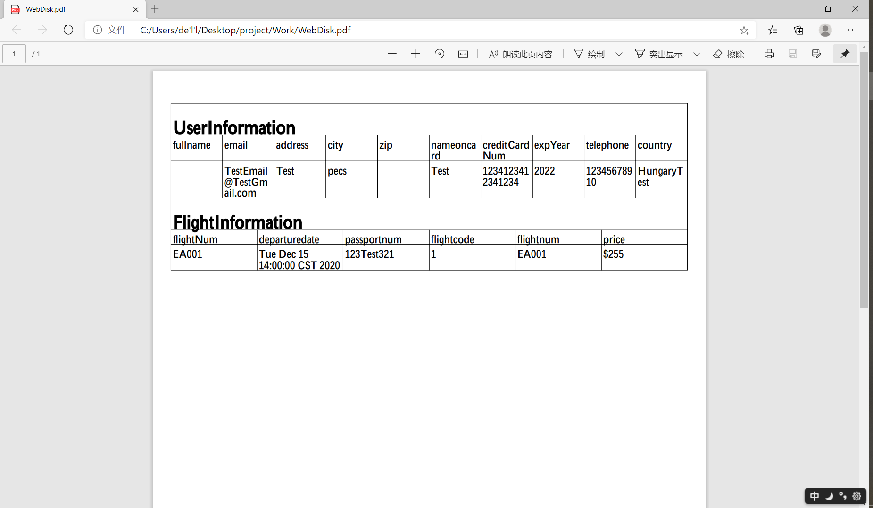
This is a example

Slide 41
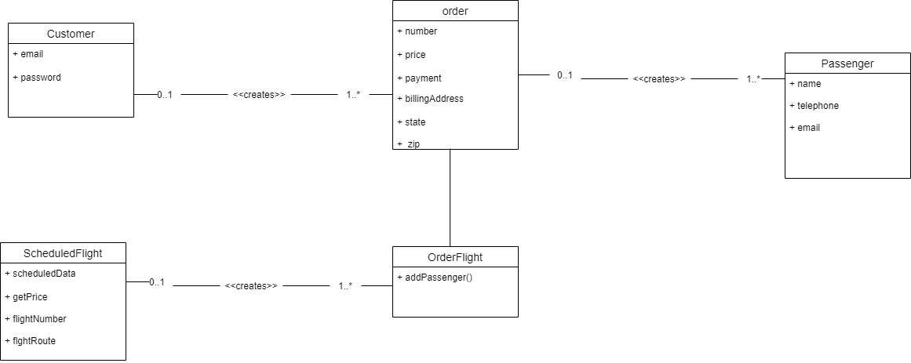

Slide 42
